Slide 1

Data Science Project

Slide 2

Health Insurance Cross Sell Prediction

Slide 3

Problem Statement
Subtitle Vehicle insurance prediction.
Prediction of vehicle insurance using health insurance.
An insurance company that has provided Health Insurance to its customers now they need to have a model to predict weather the policyholders from past year will also be interested in Vehicle insurance provided by the company.
Insurance policy is an arrangement by which a company undertakes to provide a guarantee of compensation for specified loss,damage or death in the return fot the payment of specified premium.

Slide 4
Data
The below is the data provided by the company.
Gender, Age, Driving License, region code, previous insured, vehicle age, vehicle damage, Annual Premium, policy sales channel and vintage are the independent variables, Response is the dependent variable.
The variables like Driving License, vehicle age, previous insured and vehicle damage are the important variable and there is no correlation between them but have a relationship with the dependent variable response.
id | Gender | Age | Driving License | Region Code | Previous Insured | Vehicle Age | Vehicle Damage | Annual Premium | Policy Sales Channel | Vintage | Response
1 | Male | 44 | 1 | 28.0 | 0 | > 2 Years | Yes | 40454.0 | 26.0 | 217 | 1
2 | Male | 76 | 1 | 3.0 | 0 | 1-2 Year | No | 33536.0 | 26.0 | 183 | 0
3 | Male | 47 | 1 | 28.0 | 0 | > 2 Years | Yes | 38294.0 | 26.0 | 27 | 1
4 | Male | 21 | 1 | 11.0 | 1 | < 1 Year | No | 28619.0 | 152.0 | 203 | 0
5 | Female | 29 | 1 | 41.0 | 1 | < 1 Year | No | 27496.0 | 152.0 | 39 | 0
4

Slide 5
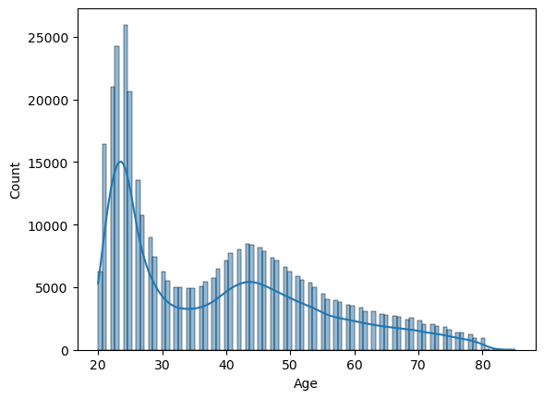
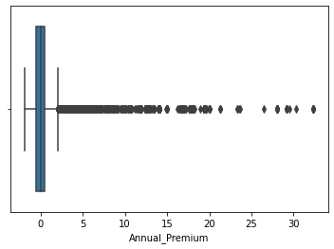
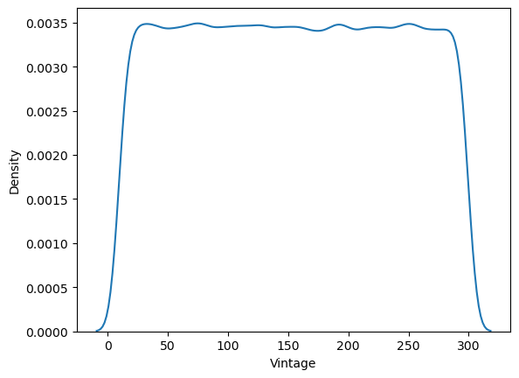

Approach
As I mentioned in the previous slide all the variables are having the relationship with dependent variable except Id as it is contain of all the unique values for each and every record, so we have to drop the Id variable to reduce the bias of the model.
Age, Annual Premium, Vintage this variables are not in normal distributions and having many outliers in it. I have used robust scaler method to bring it near to the normal distribution.
5

Slide 6
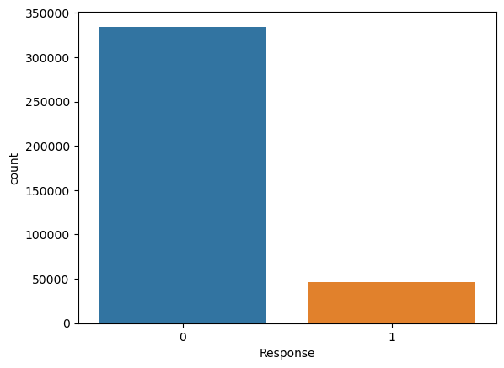
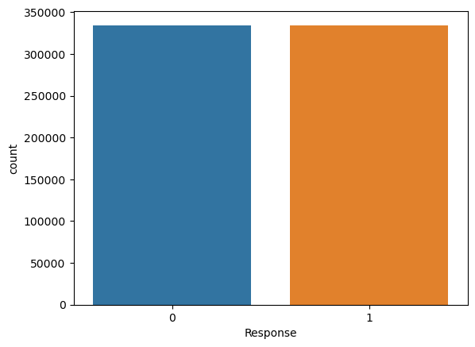
We have some categorical variables(Vehicle Age, Gender, Vehicle Damage) that are converted to numeric by using label encoding method.
Vehicle Age | Gender | Vehicle Damage
> 2 Years | Male | Yes
1-2 Year | Male | No
< 1 Year | Female | No
Vehicle Age | Gender | Vehicle Damage
2 | 1 | 1
0 | 1 | 0
1 | 0 | 0
Encoding
Dependent variable is imbalance, so we need to balance it by performing random oversampling are SMOTE method.
Random oversampling

Slide 7
Model Selection
Started building up with the basic models, as we have many outliers the basic models will not perform good.
So going with the tree based are ensemble models the model performed better when compared with the base models.
Performance of Decision Tree is better than all other models, so we will be going with it.
Model Name | Performance
Logistic Regression | 78%
Naïve Bayes | 78%
Decision Tree | 94%
Random Forest | 94%
Gradient Boosting | 80%
XG Boost | 81%
Cat Boost | 82%

Slide 8
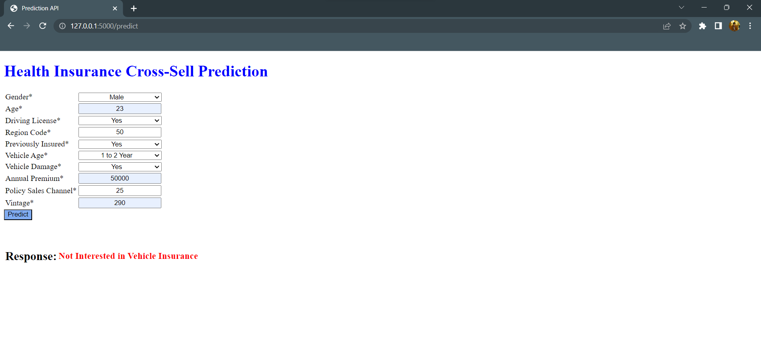
This is the website designed for the end user to provide there inputs here.
Base upon the inputs the user or the company can get to know that the customer is interested are not.
We can see the result near the response text.
With this we got to know that we can build a website to the company with CI CD pipeline.
8

Slide 9


Thank You
M Tapasswin
Manchala.tapasswin955@gmail.com

